Slide 1
FINGER VEIN EXTRACTION AND AUTHENTICATION FOR SECURITY PURPOSE
Presented By:
Aayush Sinha– 1031310150
Ajay Bhadu – 1031310312
Batch : B146
Project Guide:
Mr. A. Selva Kumar, Assistant Professor, SRM

Slide 2
Abstract
Biometrics have been used for authentication and security for a long time. The most common biometric methods are fingerprint, iris scanner, face recognition, voice recognition, etc. But the fact is that these methods are not failsafe or fully secure. Hence, newer methods have been introduced in recent times that are more efficient and reliant. One of the best methods of biometric authentication is finger-vein technology. It is one of the most secure, reliable and efficient biometric mechanisms. In this paper, we study the complete implementation of finger-vein authentication system and use it as a biometric method to provide vehicle security.
The project has a software and hardware component. The software component deals with the complete image processing process using MATLAB and checking for authenticity of the input image. We propose a finger-vein technique that uses HAAR transform in the Discrete Wavelet Transform to perform the feature extraction and SVM classifier for training the data set. The performance is measured using the mean squared error (MSE) and peak signal to noise ratio (PSNR). Hardware component uses the Arduino microcontroller which will be used to decide whether the ignition will be switched on or not depending on the result of the authentication.

Slide 3
INTRODUCTION
Biometric methods are methods that use features of human beings for authentication. Since the features such as fingerprints, voice, iris, etc are unique in each person, the security provided is very high when compared to conventional methods like passwords. These may include fingerprints, palm prints, iris scanners, voice recognition, face recognition etc. Finger vein recognition is a method of biometric authentication that uses pattern recognition techniques based on images of human finger vein patterns beneath the skin's surface. Finger vein recognition is one of many forms of biometrics used to identify individuals and verify their identity. Finger Vein ID is a biometric authentication system that matches the vascular pattern in an individual's finger to previously obtain data. The technology is currently in use or development for a wide variety of applications, including credit card authentication, automobile security, employee time and attendance tracking, computer and network authentication, end point security and automated teller machines.

Slide 4
EXISTING SYSTEM AND THEIR DRAWBACKS
The current biometric systems are all subject to risk and have a higher failure rate.
Facial recognition uses a 2-D recognition system, which is susceptible to changes in lighting, the person’s hair, whether the person wears glasses and age, as people's faces change over time.
Voice recognition has low accuracy, and a voice can be easily recorded and used for unauthorized access. An illness such as a cold can alter the user's voice and make identification more difficult or even impossible.
Retinal scanning is an expensive identification method and can cause delays, as the comparison with stored templates can take up to 10 seconds.
Fingerprint reading can make mistakes with the dryness or dirt of the finger’s skin, as well as with age. Fingerprints are captured in an image format that requires a lot of memory to process

Slide 5
FINGER-VEIN SYSTEM
The need of a biometric method that is reliable and fast is solved by the finger vein recognition system. This is a method of biometric authentication which uses the patterns of the vein beneath the skin of the finger. Since this pattern is unique for each finger, verification of identity can be done. As the blood vessels are beneath the surface of the skin, forgery is not possible. Also, the physical presence of the human is guaranteed as the authentication cannot be done otherwise. The authentication process matches the previously recorded pattern available in the database for authorisation.

Slide 6
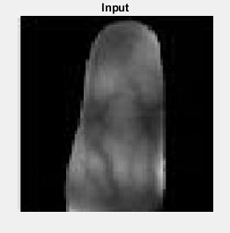
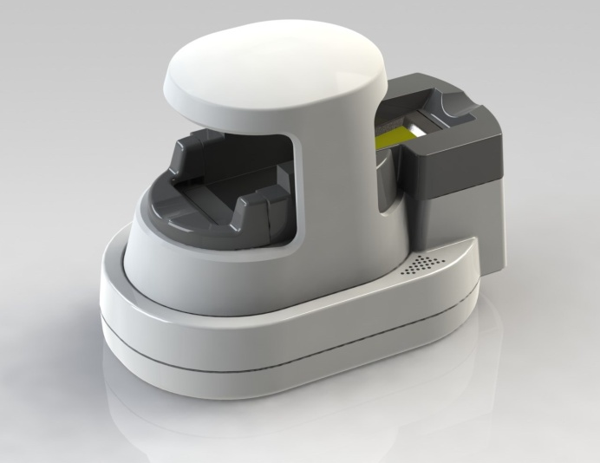
FINGER-VEIN IMAGE AND MACHINE

Slide 7
ADVANTAGES OF FINGER VEIN TECHNOLOGY
Accurate-Rates for acceptance of false users or rejection of true users are among the lowest for biometric technologies, making finger vein authentication a reliable security solution.
Fast-Vein pattern matching is completed within the blink of an eye, affording users a speedy authentication experience.
Secure- As finger vein patterns are found internally within the body, forgery is extremely difficult. Dryness or roughness on the surface of the skin also has no effect on the accuracy of vein pattern authentication.
Small-Finger vein authentication devices are compact and therefore applicable as embedded devices in a variety of applications.
Non Traceable-Veins are inside the body, invisible to the eye, and not accessible.
User-Friendly- The vein patterns of each finger are unique, so each individual can register multiple fingers as "back-up" for authentication purposes.

Slide 8
IMPLEMENTATION
REQUIREMENTS
HARDWARE TOOLS:
Arduino Micro-controller
GSM
MOTOR
SOFTWARE TOOLS:
Arduino IDE
MATLAB
Language: Embedded C

Slide 9
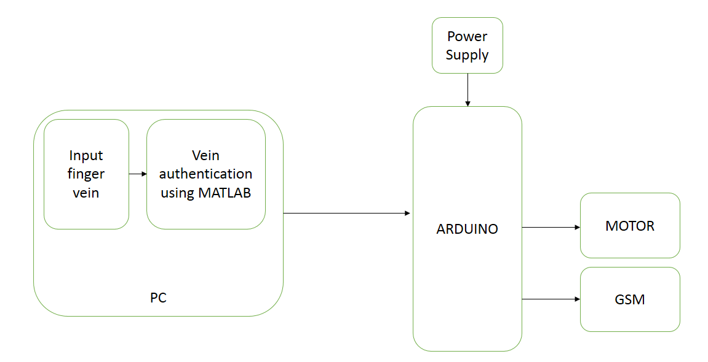
BLOCK DIAGRAM

Slide 10
SOFTWARE ARCHITECTURE
Input Image
Pre processing (Noise Removal)
Segmentation
Feature extraction
SVM Classifier
Trained dataset
RESULT

Slide 11
MODULE 1 Input, Pre-processing and Segmentation
This module requires the collection and storage of images of finger veins.
Pre-processing includes removal of noise levels, resizing of the image, localization of the image, improving clarity and removal of distortion.
Segmentation includes partitioning of the image into multiple segments for further processing.

Slide 12
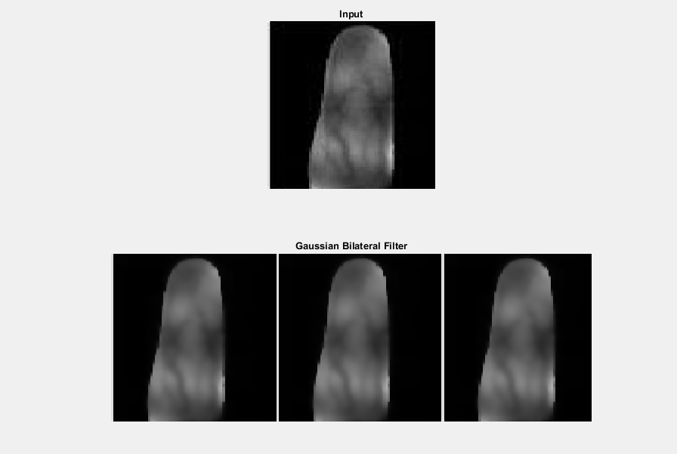
NOISE REMOVAL: GAUSSIAN FILTER

Slide 13
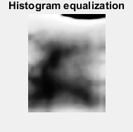
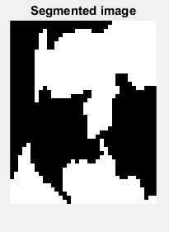
IMAGE EQUALIZATION AND SEGMENTATION

Slide 14
MODULE 2 Feature Extraction
In feature extraction, algorithms are used to detect and isolate various desired portions or shapes (features) of a digitized image.
We have used discrete wavelet transform (DWT) to extract the features.
Mean: Mean value gives the contribution of individual pixel intensity for the entire image. It is basically a texture feature that represents the average pixel value of the given image. Mean is used in noise filtering as well.
Variance: Variance is normally used to find how each pixel varies from the neighbouring pixel (or centre pixel) and is used in classify into different regions. It can also be used to determine edge position
Standard Deviation: Standard Deviation shows how much variation or dispersion exists from the average (mean, or expected value). A low value of standard deviation shows that the points are in proximity to the mean while high standard deviation shows the points are widely spread. The standard deviation is calculated and the value is assigned to the central pixel.
Entropy: Entropy gives information about the texture of the image. Entropy can be measured from the histogram of an image. In an 8-bit pixel there are 256 states. If all such states are equally occupied, spread of states is maximum. In this case, the entropy value will be maximum and vice-versa.
Skewness: Skewness is gives an idea about the surface of the image. Darker surfaces have higher skew values than lighter values. Skewness can be used to measure the edge of an image that has a white background.
Kurtosis: In general, Kurtosis is used to determine if a distribution is flat or has a peak. It is a measure of the shape of the distribution. Kurtosis values are related to noise and resolution of the image.

Slide 15
MODULE 3 Training of data set using SVM and matching
Support vector machines (SVMs) are supervised learning models with associated learning algorithms that analyze data used for classification and regression analysis.
SVMs are one of the best known methods for pattern and image classification
SVMs are used to separate a set of training in two different classes. Hence, when there are two classes and the image is to be classified as one of them, the SVM classifier is used.
Based on the features extracted of the input images, the data set is trained to be in one of the categories of 'authenticated' or 'not authenticated'

Slide 16
MODULE 4 Arduino Microcontroller and Motor
Arduino is an open-source electronics platform based on easy-to-use hardware and software.
Arduino boards are able to read inputs - light on a sensor, a finger on a button, or a Twitter message - and turn it into an output - activating a motor, turning on an LED etc.
Instruction to the board can be sent by sending a set of instructions to the microcontroller on the board.
To do this we will use the Arduino programming language (based on Wiring), and the Arduino Software (IDE), based on Processing.

Slide 17
MODULE 5 GSM and Error Message
This component is for the error message to be sent to the user if authentication is not done.
In the event of non-authentication, the arduino controller will send a message to the user, informing him of the non-authentication.
This will allow for safety of the user if some malicious activity takes place.
The contact details can be edited and updated according to the user.

Slide 18
APPLICATION IN VEHICLE SECURITY:
One of the application of using finger vein technology is to make an authentication system to provide vehicle security. The result from the finger-vein authentication can be used to decide whether the ignition of the vehicle should switch on or not. The database of the finger vein images of the people who are authorised to drive that vehicle can be recorded and kept. The finger-vein scanner will be attached to the microcontroller that will decide if the ignition can be switched on or not. On successful authentication of the person, a signal will be sent to the microcontroller, that will allow the ignition to switch on. If the authentication is not successful, a message can be sent to the real owner intimating about the unsuccessful attempt at authentication. This method can be used to prevent vehicle thefts and provide security to vehicles.

Slide 19
CONCLUSION AND RESULTS
The performance of the model is measured using two parameters- Mean square error (MSE) and peak signal to noise ratio (PSNR) [18-19]. Peak Signal to Noise Ratio ( PSNR) and Mean Square Error (MSE) are used to compare the squared error between the original image and the new trained image. There is an inverse relationship between PSNR and MSE. Higher the value of PSNR, better is the quality of the image.

Slide 20
RESULT VALUES
Image \ Parameter | Mean Squared Error | Peak Signal to Noise
1 | 9.9691e-04 | 78.1443
2 | 4.1199e-04 | 81.9820
3 | 0.0013 | 77.0014
4 | 1.2716e-04 | 87.0874
5 | 0.0011 | 77.5450
6 | 0.0015 | 76.2956

Slide 21
REFERENCES
[1]Hashimoto J.,“Finger Vein Authentication Technology and its Future”, 2006 Symposium on VLSI Circuits, Digest of Technical Papers, pp. 5-8, 2006.
[2] Lee H, S. H. Lee, T. Kim, and H. Bahn, “Secure User Identification for Consumer Electronics Devices”, IEEE Transactions on Consumer Electronics, Vol. 54, No. 4, pp. 1798-1802, Nov. 2008.
[3] Desong Wang, Jianping Li, and Gokhan Memik, “User Identification based on Finger-vein Patterns for Consumer Electronics Devices”, IEEE Transactions on Consumer Electronics, Vol. 56, No. 2, pp. 799-804, May 2010.
[4] V.R.Vijaykumar et al. "Fast and Efficient Algorithm to Remove Gaussian Noise in Digital Images" IAENG International Journal of Computer Science, 37:1, JCS_37_1_09 1 Feb, 2010.
[5] Wu J. D., and S. H. Ye “Driver Identification using Finger-Vein Patterns with Random Transform and Neural Network”, Expert System Applications, Vol. 36, pp. 5793-5799, 2009.
[6] S. P. Lloyd, “ Least squares quantization in PCM ”, IEEE Trans. Inf.Theory, vol. IT-28, no. 2, pp. 129 – 136, Mar.1982.
[7] Ramakrishnan S. et al., "SVD Based Digital Image Watermarking Using DWT", Proceedings of the National Conference on Intelligent Computing and Control Engineering Applications, pp. 83-86, Anna University of Technology, Coimbatore.
[8] G. Xuan, Q. Yao, C. Yang, J. Gao, P. Chai, Y. Q. Shi, and Z. Ni. "Lossless data hiding using histogram shifting method based on integer wavelets". 2006, Proc. Int. Workshop on Digital Watermarking, Vol. 4283, pp.323–332.
[9] Wen-Chang C, Ding-Mao J. "Triaxial Accelerometer-Based Fall Detection Method Using a Self-Constructing Cascade-AdaBoost". Biomedical and Health Informatics, IEEE Journal. 2013; pages 411-419.
[10] Anita Pati Mishra "Noise Smoothing- Improving Image Filtering Methodology" International Journal of Research Volume 03 Issue 09 May 2016.

Slide 22
CONTD...
[11] Ms.Seema Rajput Prof.S.R.Suralkar "Comparative Study of Image Enhancement Techniques" IJCSMC, Vol. 2, Issue. 1, January 2013, pg.11 – 21.
[12] Rajesh Garg, Bhawna Mittal "Histogram Equalization Techniques For Image Enhancement" IJECT Vol. 2, Issue 1, March 2011.
[13] Wang, Z., Bovik, A.C., Sheikh, H.R., & Simoncelli, E.P (2004) Image quality Assessment: from error visibility to structural similarity. IEEE Tran. Image Processing 13(4), pp. 600-612.
[14] Tara Saikumar et al. "Colour Based Image Segmentation Using Fuzzy C-Means Clustering" 2011 International Conference on Computer and Software Modelling IPCSIT vol.14 (2011).
[15] Ravindra S et al. "Segmentation of Google Map Images Based on Color Features" Proceedings of International Conference on Communication, Computation, Management & Nanotechnology (ICN-2011), September 23-25, 2011.
[16] Murali Mohan. S et al. "VLSI Architecture for Fast Computation of 2D-Discrete Wavelet Transform and Low Power Feed Forward Neural Network Architecture for Image Compression" American Journal of Engineering Research (AJER) e-ISSN : 2320-0847 p-ISSN : 2320-0936 Volume-02, Issue-10, pp-136-145 www.ajer.org.
[17] Kamrul Hasan Talukder, Koichi Harada "Haar Wavelet Based Approach for Image Compression and Quality Assessment of Compressed Image" IAENG International Journal of Applied Mathematics, Volume 36, Issue 1, 2007.
[18] Cui, L., & Allen, A.R. ." An Image Quality Metric Based on a Colour Appearance Model". 2008 Proceedings of the 10th International Conference on Advanced Concepts for Intelligent Vision Systems, France, pp.696-707.

Slide 23
THANK YOU

